Slide 1





History, and Evolution of SCADA
© 2017 General Electric Company. All rights reserved.

Slide 2



Origin and Purpose of SCADA

Slide 3






Millions
Of miles of distribution
One of the
Biggest Machine on Earth - America’s Power System
10,000
Power Plants
½ Million
Miles of Transmission
55,000
Substations

Slide 4

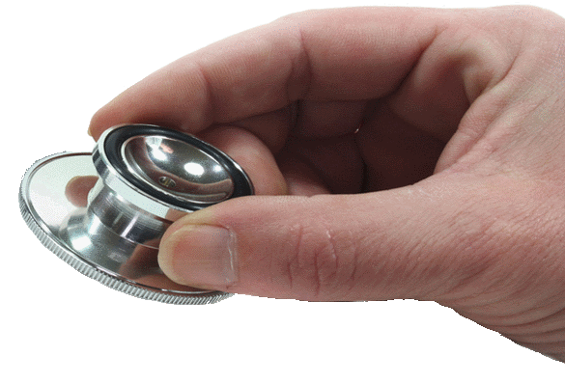
Biggest Machine on Earth
Goal is to optimize the power production and delivery process
The collection, secure transfer, and analysis of end-to-end system information is required in order to achieve that goal

Slide 5



SCADA: Supervisory Control and Data Acquisition
Purpose of SCADA
Process optimization
System situational awareness
System control
Without it, essentially running blind
System state knowledge is crucial

Slide 6


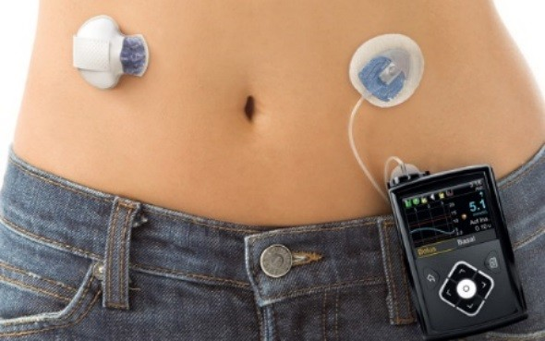
Healthcare Analogy – Wellness Care
Monitor
Various real and long-term data Weight, heart rate, insulin level
Frequency
Periodically, relatively long interval As reasonable, appropriate and directed
Event based
Goal: Find and correct health issues Maintain and optimize health

Slide 7
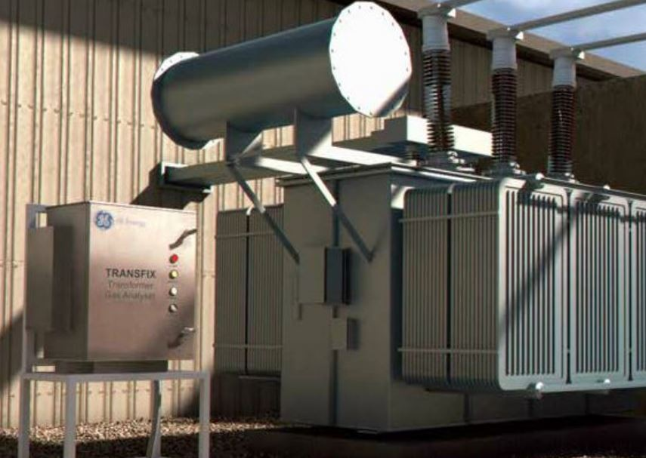
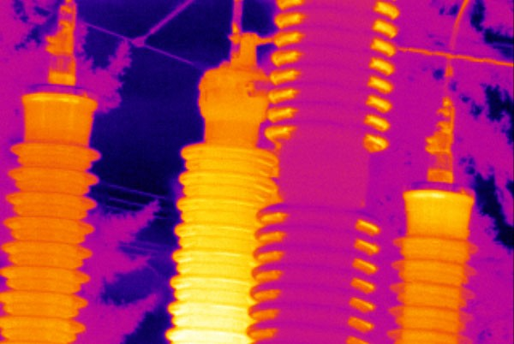
Power Production/Delivery System – Maintenance
Monitor
Various real and long-term data Temperature, power, gas concentration
Frequency
Periodically, relatively long interval As reasonable, appropriate and directed
Event based
Goal: Find and correct issues Maintain and optimize system health

Slide 8

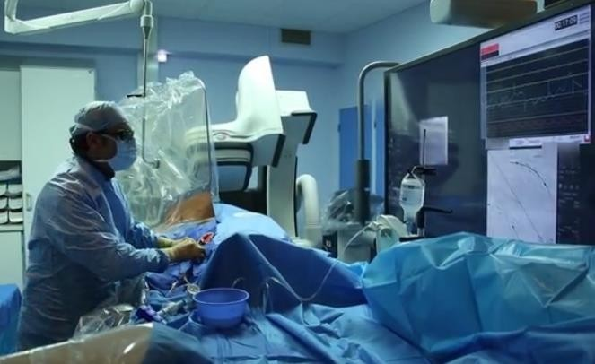
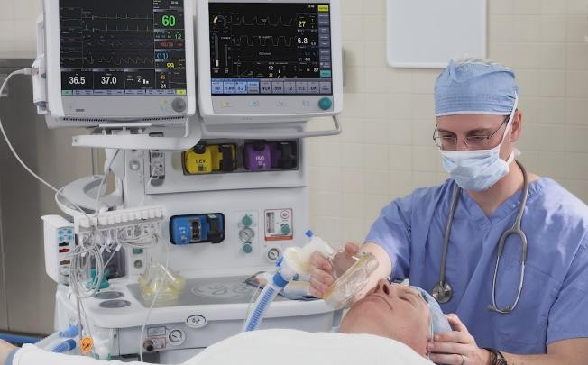
Healthcare Analogy – Emergency Room
Monitor
Critical real-time data
Heart rate, blood pressure, breathing rate
Frequency
Constant, short Interval
Actions: Immediate
Goal: Keep patient alive

Slide 9

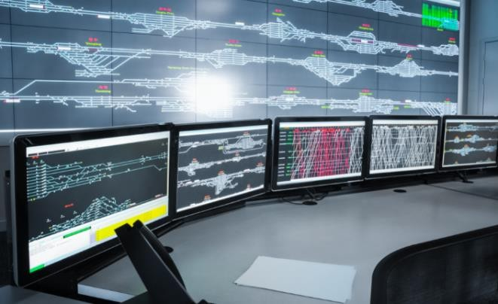
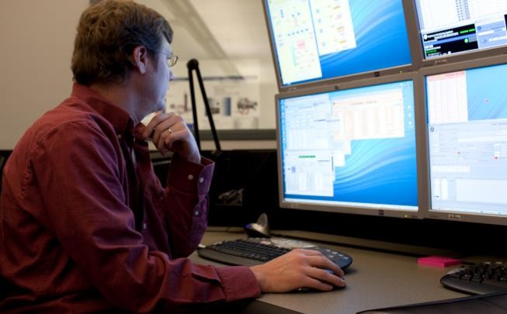
Power Production/Delivery System - SCADA
Monitor
Critical real-time data Volts, amps, power, loads
Generation availability, breaker statuses
Frequency
Constant, short Interval
Actions: Immediate
Goal: Keep system alive and operational

Slide 10

Initial Implementations: Early to mid-1900s

Slide 11



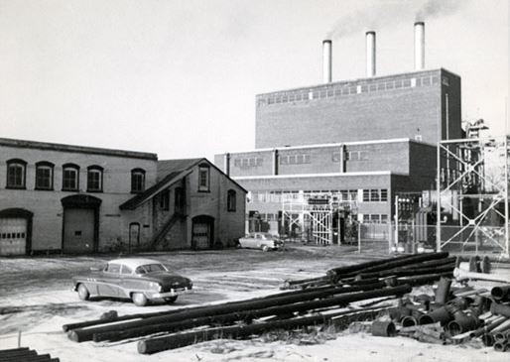

Power Plant Control Room
Power plant control rooms were first “control centers”
Extended to nearby substations for SCADA functionality
Directly-connected data sources
Device contacts
Electromechanical meters
Moran Generating Station Courtesy of the Burlington Electric Department
Burlington, Vermont
State knowledge limited to immediate facilities

Slide 12
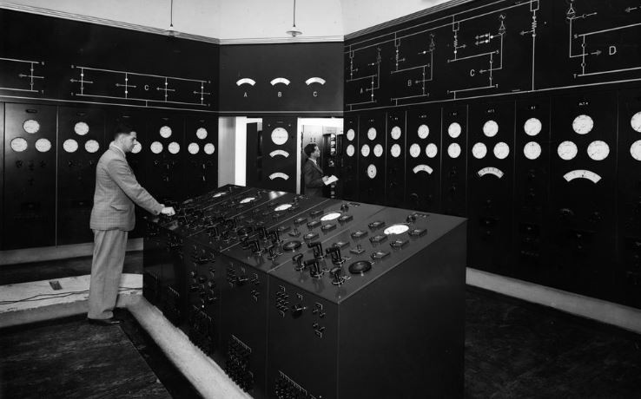
Power Plant Control Room
Power plant control rooms were first “control centers”
Essentially extended instrumentation
Dedicated discrete data indication and display board
Meters
Lamps

Slide 13


Sources and Provision of Data
Extended instrumentation impractical for distant stations
Alternative manual methods
Staffed stations
On-call local area workers
Public
Progressive application of telemetry
Simple schemes
Limited to crucial data

Slide 14

Electronic-Based Systems: 1960s-1970s

Slide 15

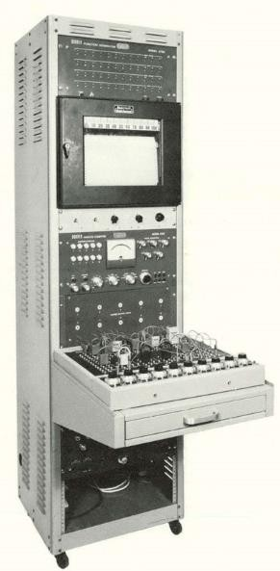
Supervisory Control and Data Collection
SCADA acronym came into use
Early implementation
Field devices, predominantly at subs
Remote data equipment (RDE)
Standalone, independent
Dedicated function
Perform data acquisition
Execute control actions

Slide 16

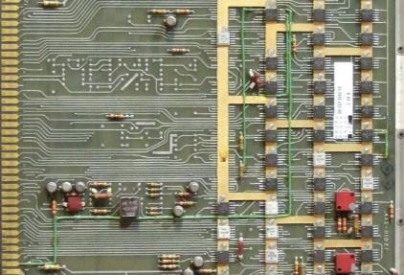
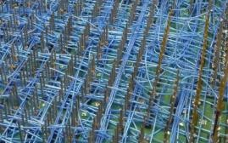
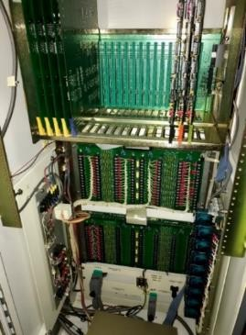
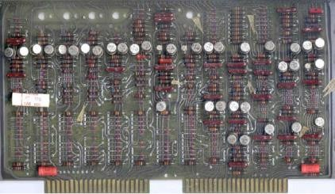
Remote Data Equipment (RDE)
Hardware
Discrete electronics
Hardware-based logic
Often wire-wound connections
Multiple large low-density PCBs
Common card-cage format

Slide 17

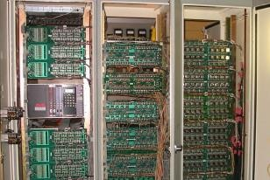
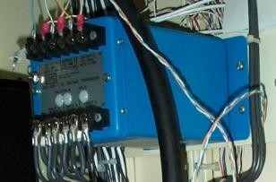
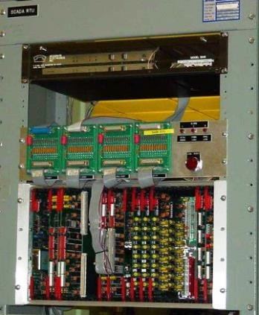
Local Input/Output (I/O)
Hard IO
Card-based
Local to RDE
Low-level analog inputs (AIs), typically
+/- 1mA transducer
Status inputs (DIs), typically equipment contacts
Control outputs (DOs)

Slide 18
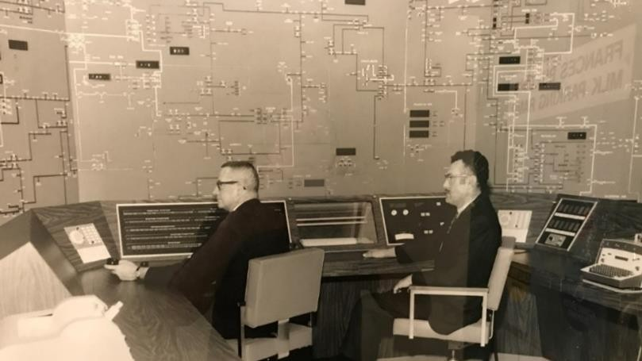
Energy Management System (EMS) Master
Computer / data processor
Communications processor
Communication with system devices
Protocol / language
Simple limited interface
Orpheum Electric building Courtesy of Iowa Electric
Sioux City, Iowa

Slide 19









Master-to-RDE Communications
Objectives
Move data
Optimize bandwidth usage
Minimize impact on processor and memory
RDE and master sourced from common vendor using proprietary vendor-specific protocol, e.g., Conitel, CDC, Telegyr
Near-zero concern for interoperability
Protocol / language
Poll-response scheme
Bit and byte orientations
Often hardware-associated
SCADA Master Station/Control Center
Comm. Links
Remote Substation
Local I/O
Protocol
Radio Microwave Spread-spectrum
Controls
HMI/SCADA
Master
Remote Terminal Unit (RTU)
Statuses
Various Media
Analogs

Slide 20
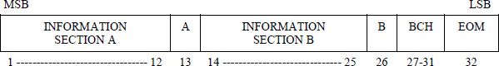
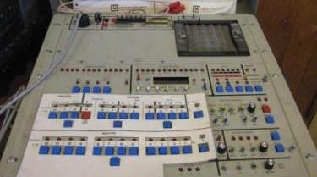
Protocol Hardware Association
Message segments match hardware I/O cards e.g., Leeds & Northrup Conitel protocol

Slide 21

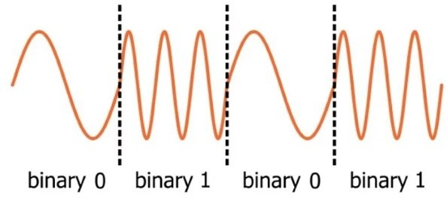
Communications Media
4-wire leased party phone lines
Microwave
Radios
Typically FSK via 1200 baud modem

Slide 22

Microprocessor-Based Systems: 1980s-1990s

Slide 23

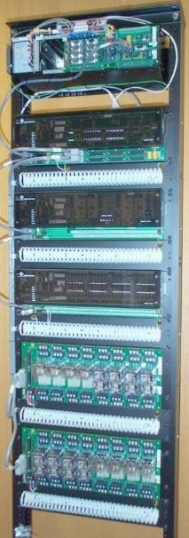
Remote Terminal Unit (RTU)
Microprocessor-based
Firmware based logic and processing
Implemented advanced functionality
PLC
Multiple master support
Calculator, etc.
Communications to master
Leased phone lines
Microwave
Radio, licensed and spread spectrum
Fiber, mostly multiplexed serial channels

Slide 24

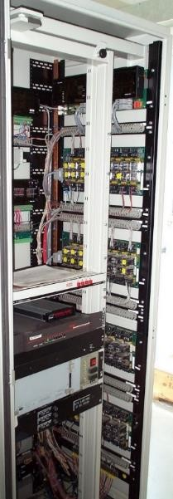
I/O and Local Communication
IO
Predominantly local hard IO
Distributed IO for large stations
Utilize data in IEDs
Meters
Relays
Controls (e.g., LTC, regulator, etc.)
Communications media to IEDs:
RS232 serial
RS485 serial
Some fiber serial
Some Ethernet, copper and fiber

Slide 25


Communication Protocols
Vendors started to emulate other vendors’ protocols
Meters
Relays
Controls (e.g., LTC, regulator, etc.)
Westronic created DNP protocol
Interoperable
Critical need for RTU-to-IED comms
Publicly released to DNP Users Group
Industry game changer

Slide 26
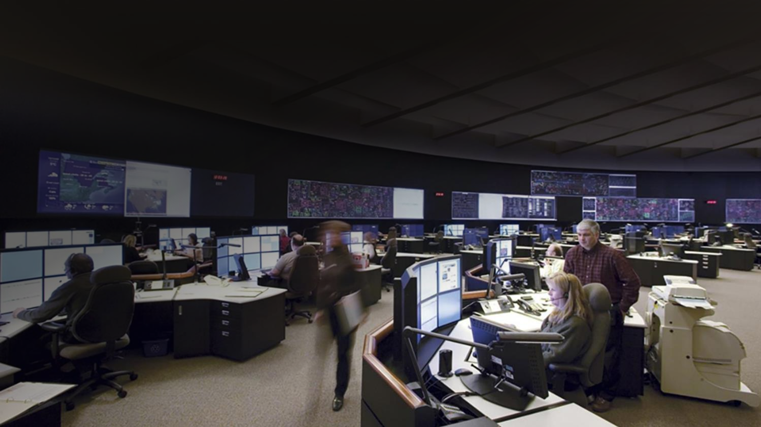

Energy Management System Master
Increased processor and memory
More remote stations monitored
Advanced graphical user interface (GUI) display board
CRT
Projection

Slide 27

Current Systems of the 2000s-2010s and the Migration to Multifunction Gateways

Slide 28

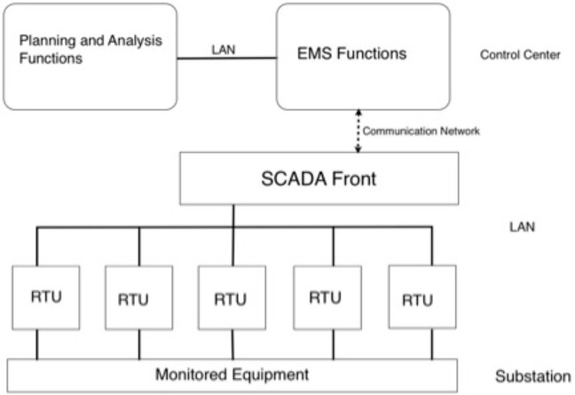
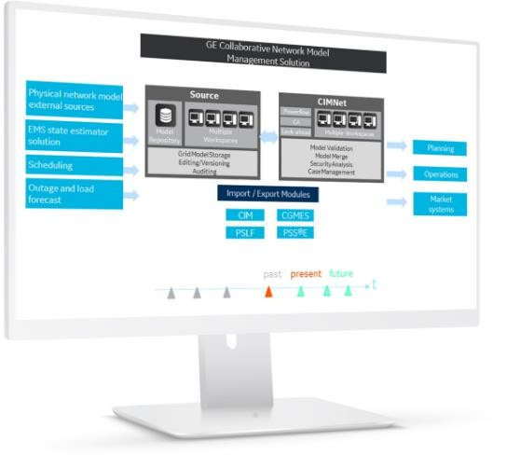
Energy Management System Master
Many continued to utilize vendor-specific protocols
Implemented advanced functionality
Load control
State estimators

Slide 29
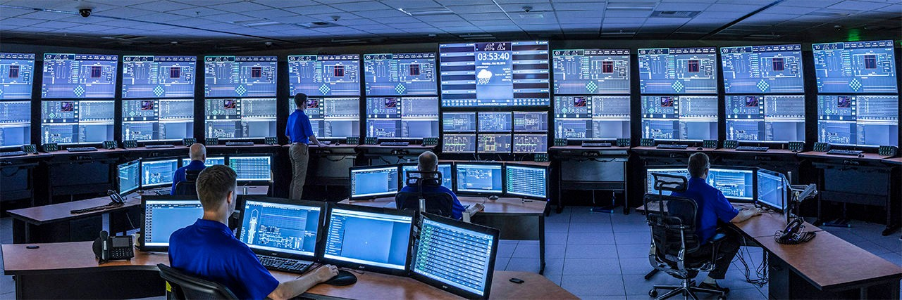
Energy Management System Master
Advanced Graphical User Interface (GUI)

Slide 30

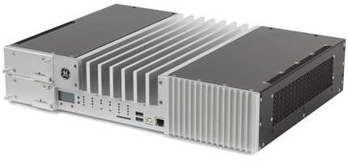
Remote Terminal Unit (RTU) / Gateway
Moved toward substation Gateway design/concept
Hard IO agnostic - Use IED data or 3rd party IO modules
Data primarily sourced from IEDs
Operational real time data
Classic status and analog values
Non-operational data
Events
Logs

Slide 31


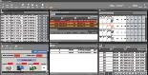



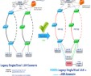
Gateway Multifunctionally
Advanced Gateway
Data collection from substation IEDs for control & secure monitoring
Embedded HMI
Customizable local or remote HMI with multiple windows
Advanced Automation Automate substation procedures using IEC 61131 compliant tools
Secure Remote Access
Securely access substation device locally and remotely
Fault Recording & Data Logging and File Retrieval
Extract valuable data such as digital fault records and event files
Redundancy
Hot & Warm-standby, PRP and HSR

Slide 32
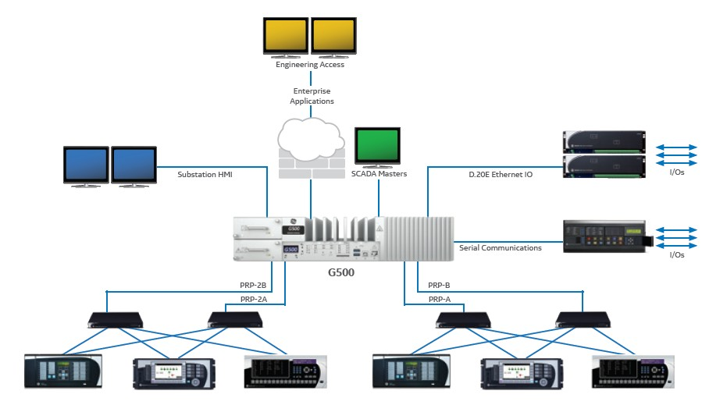
Gateway Multifunctionally

Slide 33
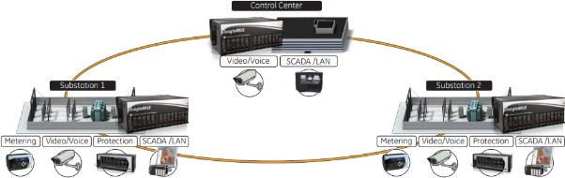
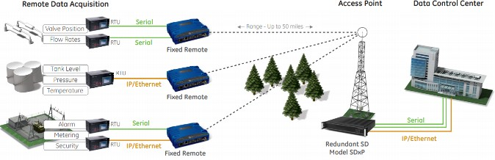
Communications Media
Drastic reduction in bandwidth constraints
Serial: 1200 baud to 56 kbaud channels
LAN: 1MB to 1GB
Frame relay, SONET, MPLS, etc.
Drastic reduction of communication costs
Standards such as Ethernet and TCP/IP
Explosion of communications market
Advances in hardware capabilities

Slide 34

Communications Protocols
Evolution of interoperable protocols
DNP additions
UCA evolution to, and development of IEC 61850
Specifies how data shall be moved
Manufacturing Message Specification (MMS)
Client/server scheme
Generic Object-Oriented Substation Event (GOOSE)
Publisher/subscriber scheme

Slide 35

Future Implementations and Direction of SCADA

Slide 36



Impacts of Technology
Wide variety of communications technologies available
Bandwidth costs no longer the driver they used to be
Greater system and device intelligence and need for situational awareness requires:
More points to be monitored and reported
More data to be obtained and processed
Increased complexity in applications
Focus is shifting from data acquisition to data management

Slide 37



Focus Shift
Data acquisition to data management
Manage huge amounts of data and datasets
Configuration of devices and applications
Maintenance of devices and applications
Updating devices
Securing devices and configurations
These will be the main cost drivers

Slide 38


Impacts of Technology
Application of data analysis tools
Processing boatloads of data into information
Mining data for useful information
Efficient reporting of data to those who need it

Slide 39


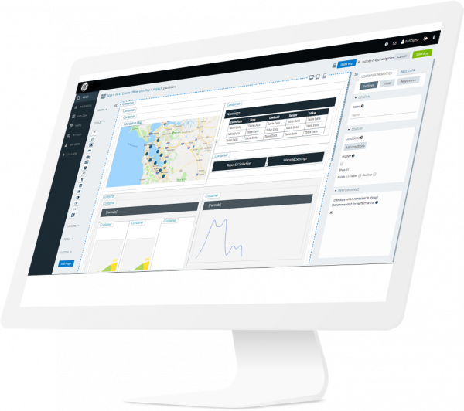
Data Management
Higher commissioning costs
More applications accessing data
Deregulation adds complexity due to increased sharing

Slide 40

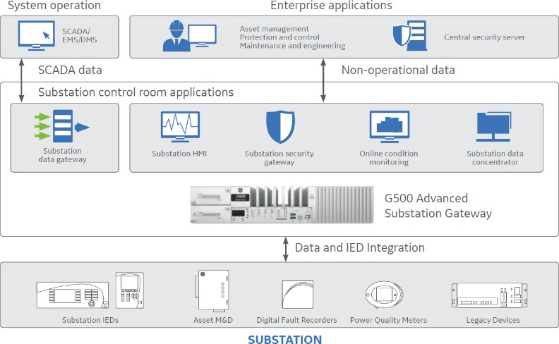
Traditional SCADA Data Management
Meanings of points maintained in multiple places
Configuration of RTU and IEDs
Configuration of databases
Configuration of applications
Protocols were primarily register based

Slide 41
Traditional SCADA Data Management
Validation is costly and time consuming
Example: Move point 3851 from its source to multiple destinations
The point is referenced by its stack location
A meaning must be assigned to the point
The meaning must be consistent and tracked throughout the system
The point must be manually managed and validated
The effort is complex and expensive

Slide 42

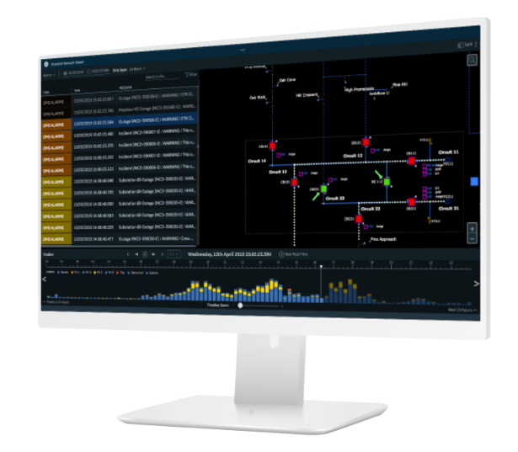
Communication and Data Management Trends
Industries moving toward object-oriented protocols
Data organized by function
Simplifies distributed applications and their management
Standardized objects for interoperability
Self-description and meta-data allow for online validation
Objects aren’t just bytes of data but also descriptions
Bandwidth is the tradeoff
Connecting applications to data is bigger effort/obstacle than the bandwidth to move it

Slide 43

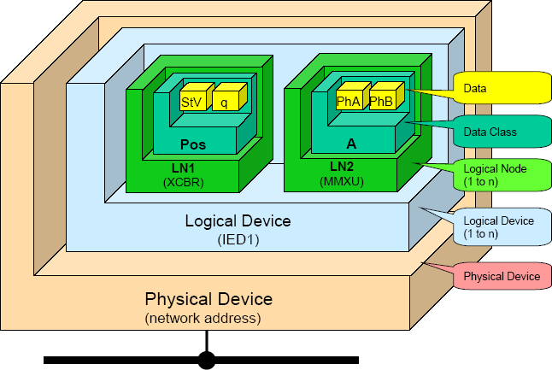
Modern Object-Oriented Protocols
Goal: Reduce data management while maintaining high integrity and reliability
IEC 61850 standard objectives
Address data management costs via modern communication techniques
High degree of interoperability via standard objects
Simplify config effort via common config language
On-line validation of comm via metadata and self-description
Source: “UCA & 61850 for Dummies.” – Douglas Proudfoot

Slide 44
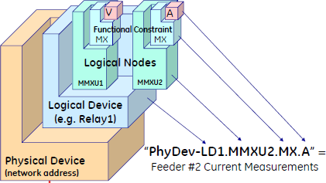
Modern Object-Oriented Protocols
IEC 61850
Much broader than traditional protocols
Multiple protocols
GOOSE, MMS, Sampled values
Standardized configuration language
Substation Configuration Language (SCL)
Extensible Markup Language (XML)
Standard and extensible objects
Naming
Data types

Slide 45

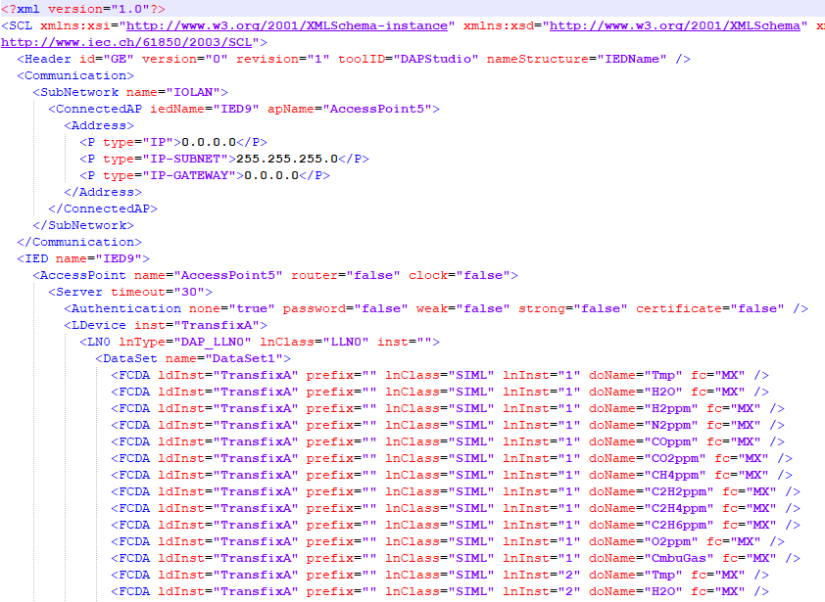
SCL CID Example File

Slide 46

Advanced Functionality
Gateway Evolution
Advanced functionality
Time synchronization and distribution: IRIG-B, SNTP, PRP
Programmable logic
Non-operational file gathering and reporting
Advanced processing platform
Virtual machines
Multiple OS environment
Container-based technology
Downloadable Apps
Application 1
Application 2
Application 3
Application 4
Application 5
Windows App 1
Windows App 2
Container Engine (Digitally Signed)
Optional Windows
Host Operating System

Slide 47


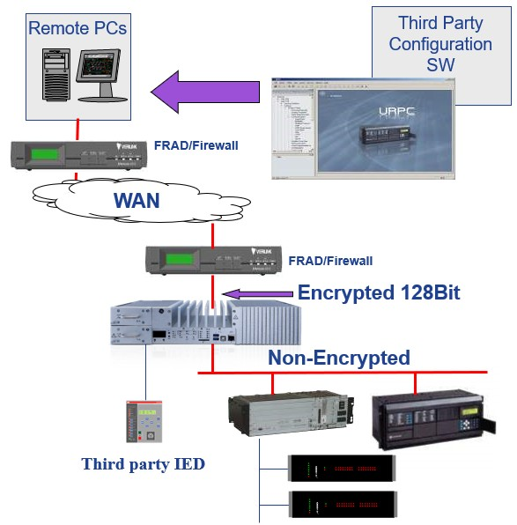
Gateway Security
Authentication, authorization, and audit trails
Secure perimeter access point and gateway
Remote tunneling (pass-through) connection to IEDs
Secure protocols
Secure firmware, configs, hardware
Automated retrieval and reporting
Password management
Firmware management

Slide 48


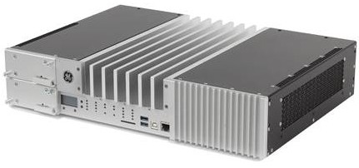
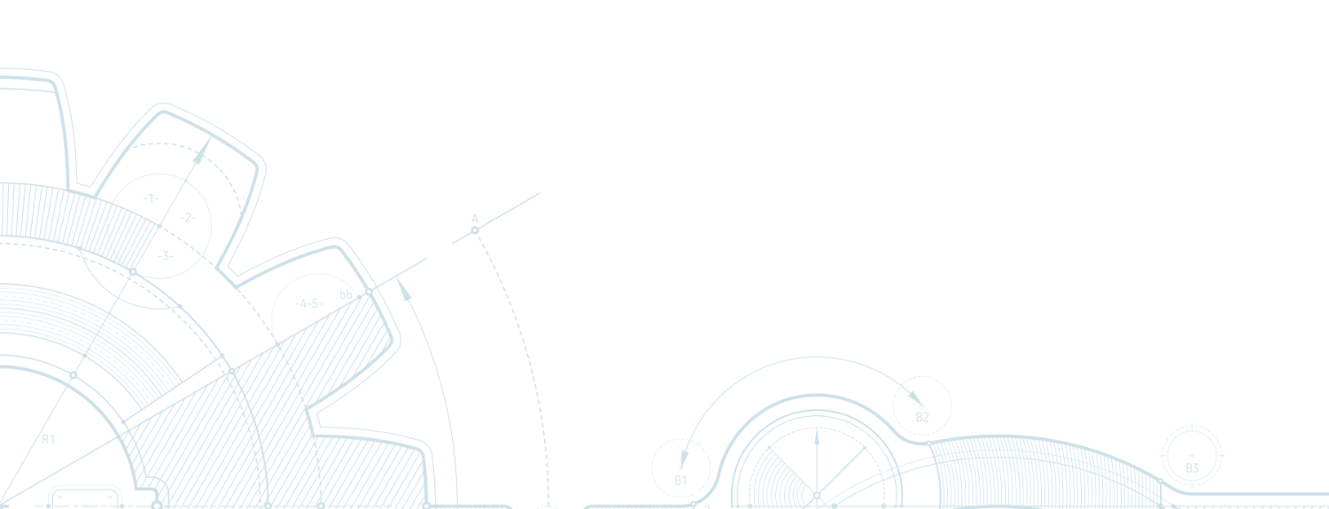

Summary
Substation RTU
– Moving toward a multifunction gateway platform with
advanced functionality
Substation Data
Volume will increase, primarily non-operational data
Efficient, reliable, and secure management of data will be main objectives
Application of analytical tools to convert data to useful information

Slide 49
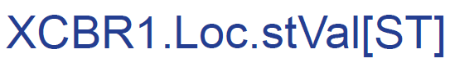

Summary
Communications
Industry is moving toward object-oriented communications and protocols
Interoperability, validation, self-identification will be key objectives
Cybersecurity
Critical infrastructure protection will be crucial focus
Automated management of firmware and passwords is key
Compliance with mandates from governing bodies

Slide 50


Questions?
© 2020 General Electric Company. All rights reserved.
© 2017 General Electric Company. All rights reserved.

